Slide 1
Central Vs Peripheral Blood Pressure Clinical Relevance
Dr Jomy V Jose
Senior Resident
Department of Cardiology

Slide 2
Blood Pressure
The shape of the pressure waveform changes continuously throughout the arterial tree.
Although diastolic and mean arterial pressures are relatively constant, systolic pressure may be up to 40 mmHg higher in the brachial artery than in the aorta.
This phenomenon of systolic pressure amplification arises principally because of an increase in arterial stiffness moving away from the heart.

Slide 3
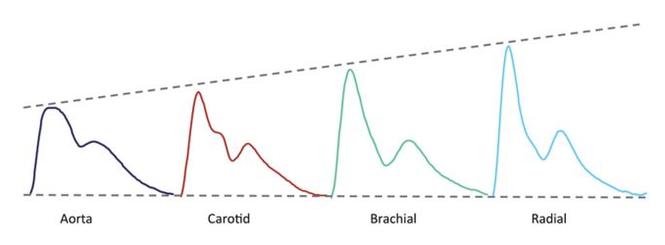
As the pressure wave travels from the highly elastic central arteries to the stiffer brachial artery, the upper portion of the wave becomes narrower, the systolic peak becomes more prominent, and systolic pressure increases

Slide 4
Arterial waveform analysis, assumes that the arterial pressure waveform is a composite of a forward travelling wave, generated by left ventricular ejection, and a backward-travelling reflected wave arising from sites of impedance mismatch—i.e. arterial taper and differences in vessel stiffness, which often occur at bifurcations.
This change in impedance is thought to generate numerous reflected ‘wavelets’ that sum together to produce a single ‘effective’ reflected wave, which is thought to augment, or increase systolic pressure in the central arteries.

Slide 5
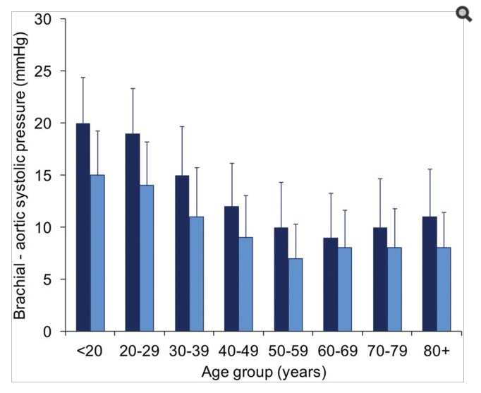

Slide 6
How to Measure Central Pressure
The most direct method involves cardiac catheterization and recording of the blood pressure in the ascending aorta using a pressure-sensing catheter.
Non-invasive methods, where pressure waveforms are recorded from sites distal to the aorta, such as the carotid, radial or brachial arteries, and calibrated to blood pressure recorded by cuff sphygmomanometry.

Slide 7
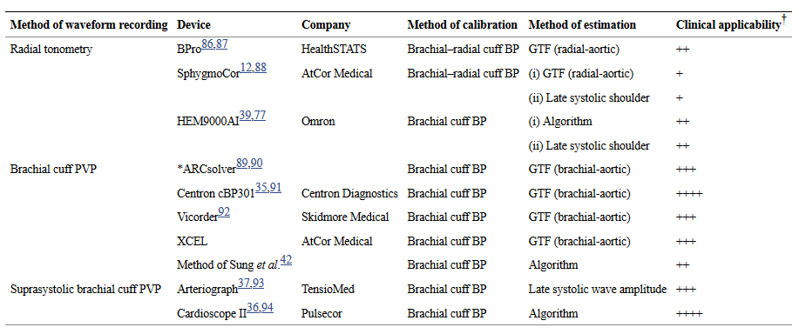

Slide 8
The heart, kidneys, and major arteries supplying the brain are exposed to aortic rather than brachial pressure. Therefore, there is a strong rationale to believe that cardiovascular events may ultimately be more closely related to central rather than brachial pressure.
Central pressure is more closely correlated with widely accepted surrogate measures of cardiovascular risk such as carotid intima-media thickness (CIMT) and left ventricular mass (LVM), than brachial pressure in cross-sectional studies

Slide 9
Longitudinal observations provide greater support for the potential value of central pressure measurement. In the REASON Study, regression of LVM was more strongly related to change in central compared with brachial pressure and, after adjustment, only central pressure remained predictive. Similar observations were made in a substudy of ASCOT. Moreover, with anti-hypertensive therapy, the reduction in CIMT relates better to the fall in central pressure

Slide 10
ANBP2 and Framingham Heart Study
Did not detect any systolic pressure amplification between the carotid and ‘brachial’ arteries and concluded that there was no advantage in assessing central in addition to brachial pressure.

Slide 11
Strong Heart Study
Central pressure was more strongly related to future cardiovascular events than brachial pressure, in disease-free individuals.

Slide 12
The main issue with the existing studies is that they are relatively underpowered to show convincingly that central pressure is meaningfully superior to brachial values in predicting events

Slide 13
Beta Blockers
Beta blockers exert differential effects on brachial Vs central pressures.
MRC Elderly
LIFE
ASCOT
The CAFE substudy of ASCOT trial : Individuals randomized to Atenolol had a 4.3 mm of Hg higher central systolic pressure than those given Amlodipine despite identical brachial pressures.

Slide 14
Most studies are with Atenolol…
Bisoprolol also showed same results…
But…newer vasodilatory beta blockers like Nebivolol and Celiprolol may have different effects…

Slide 15
Nitrates
Although not classical antihypertensives outside the emergency setting, chronic high doses of nitrates do reduce brachial pressure despite concerns over tolerance.
Limited data also suggests low doses may reduce central pressure with no effect on brachial pressures.

Slide 16
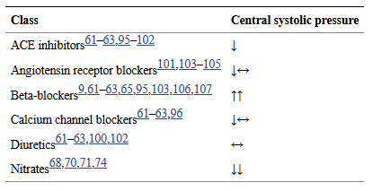

Slide 17
Hills Sign Sign or Artefact…?

Slide 18
There is difference of opinion in the literature regarding the reliability of Hill's sign.
Some studies have shown that Hill's sign is a useful indicator of aortic insufficiency but others have shown that there is no difference in systolic blood pressure in arms & legs in aortic regurgitation and
hence Hill's sign should not be used as an indicator of aortic regurgitation.

Slide 19
Braunwald Says…
The Hill sign( an exaggerated difference in systolic blood pressure between upper and lower extremities) is an artifact of sphygmomanometric measurements and is no longer considered a sign of AR….
Hutchison, Macleods, Oxford don’t mention Hills sign…

Slide 20
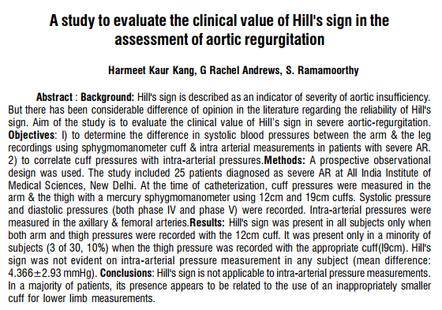

Slide 21
For noninvasive BP measurement a Standard mercury sphygmomanometer was used to take blood pressure readings in the arm and leg. Cuff size of atleast 40% of limb circumference was used i.e. for arm - l2-cm. width and for thigh - 19-cm. width.

Slide 22
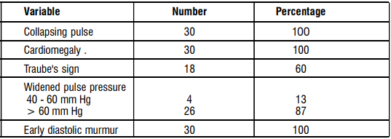

Slide 25
The present study indicates that in aortic insufficiency, intra-arterially there is no difference in systolic pressures between upper & lower limb.
It is an ar tifact of sphygmomanometeric lower limb pressure measurement. Hill's sign is largely the result of the use of inappropriate small size of cuff in the lower limb. With the use of appropriate sized cuff, Hill' sign is absent in most of the patients with severe AR.

